Slide 1
Using Neural Networks to explore ICU mortality
Emily Lau, Madeline Wood, Kathryn Macrae

Slide 2
Introduction and Methods
Research Question:
Can we develop a neural net model that can accurately predict individual mortality risk upon ICU admission using clinical, demographic and health history features?
Data Preparation:
Analysis:
Neural Networks Model
Examined descriptive statistics & missing data
Imputed missing data with median
Dropped ID and variables with >50% missing data
Recoded string variables

Slide 3
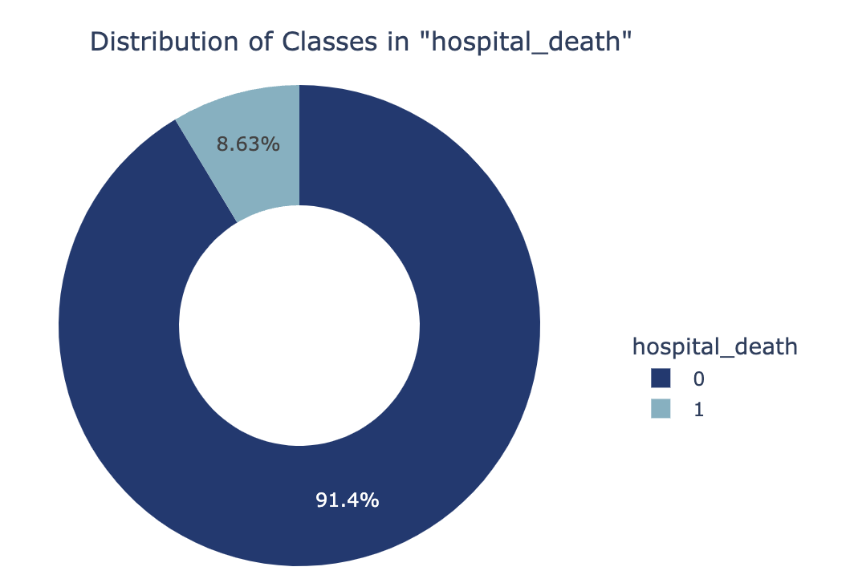
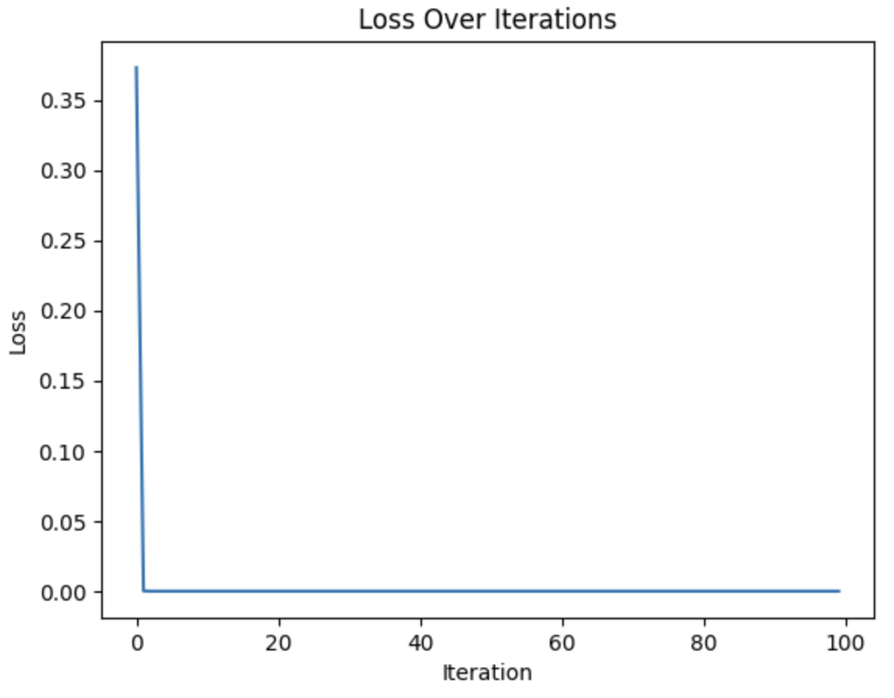
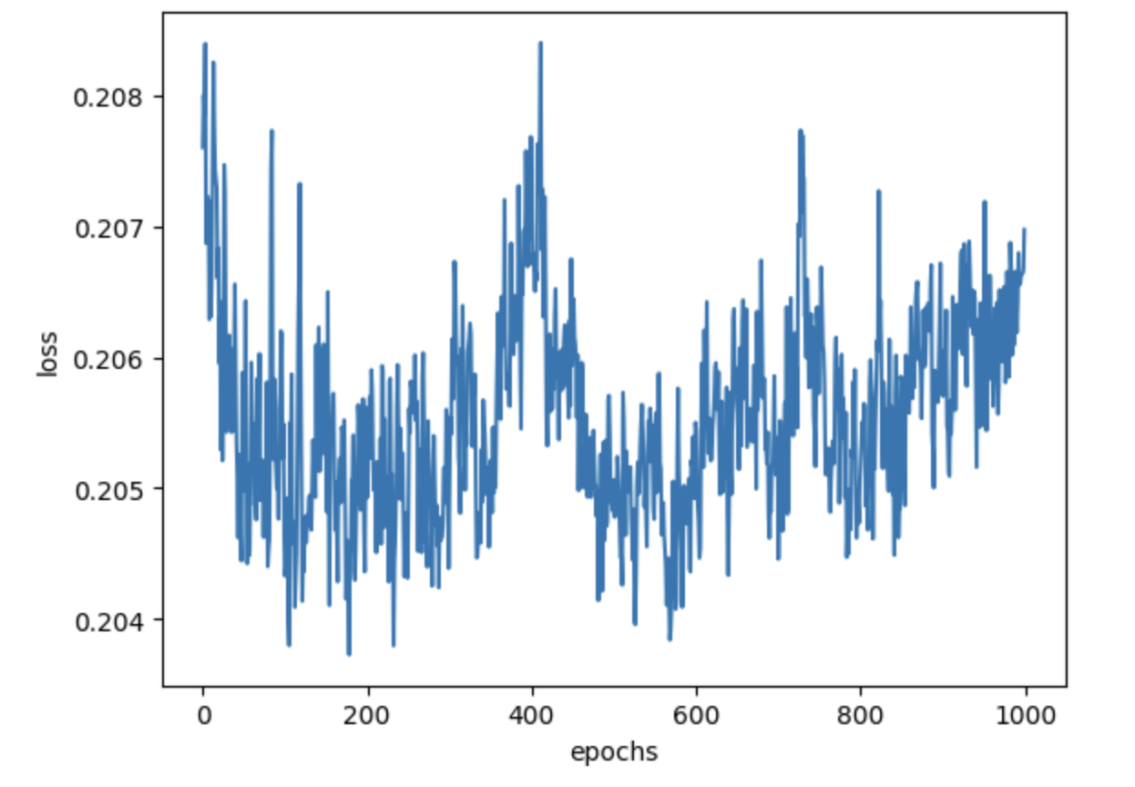
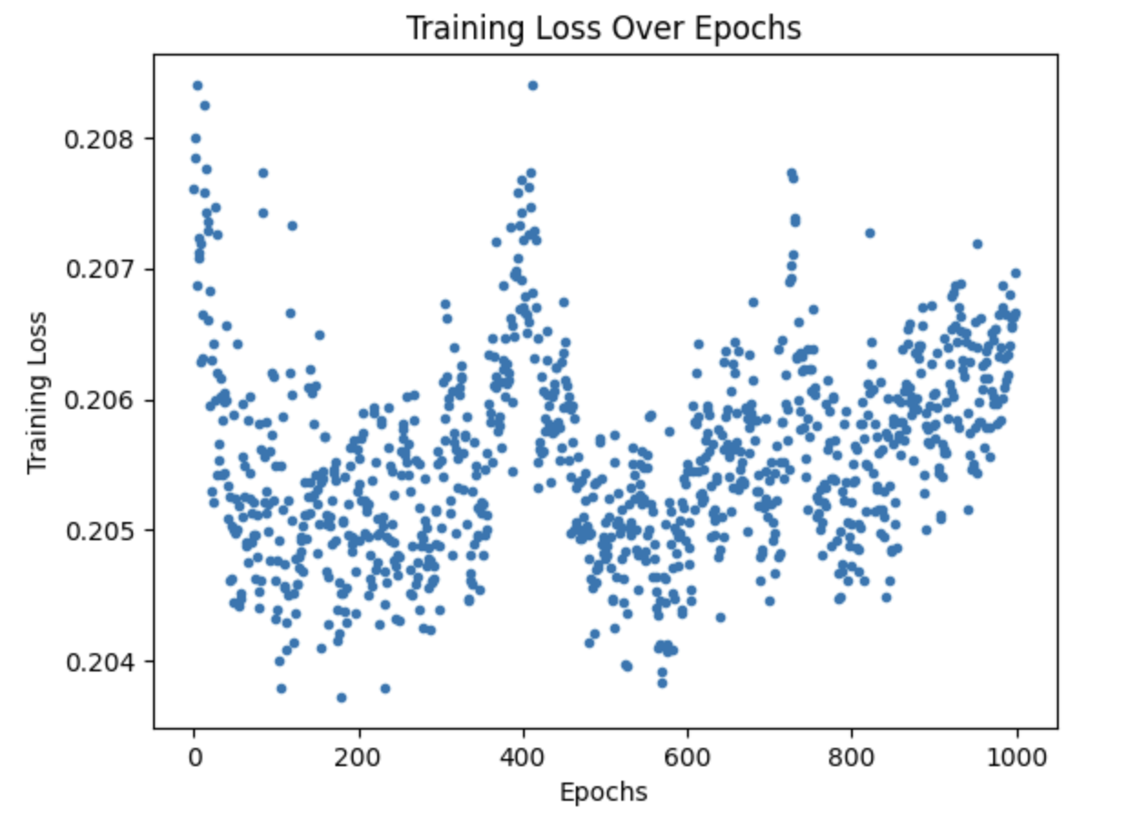
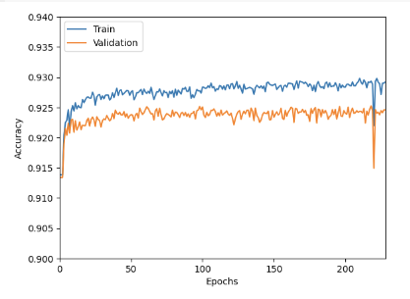
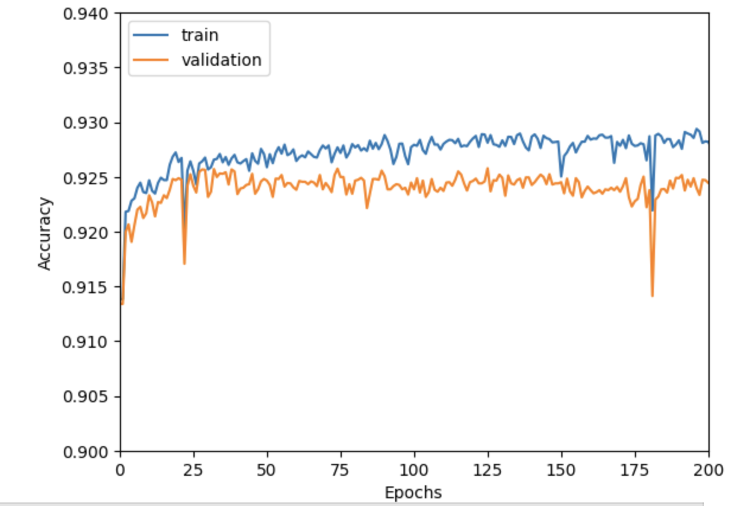
Findings

Slide 4
Conclusion
Interpretation:
Our neural network model had a high range of accuracy scores, with performance significantly dropping at certain epochs
A very large dataset was used and we also included approximately 149 features which could have contributed to some overfitting
From a clinical perspective, the large feature set may be impractical for a clinical prognostic model in the ICU context, where limited data may be collected, and quick decisions must be made rapidly on the basis of available information
Future Research:
Future research should focus on determining which features best predict hospital deaths (e.g., KNN model)
Future research should also externally validate predictive models in independent and diverse datasets to ensure generalizability

